Slide 1

Welcome

Slide 2

A.K. M Saiful Islam
Asst. Headmaster
Madhabpur Pilot High School
Email no: saifulmpur15@gmail.com
Mobile no: 01718 26 71 84
Class: Nine/Ten
Subject: English For Today
Time:50 minute
Date: 01/9/2017

Slide 3
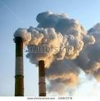
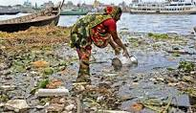
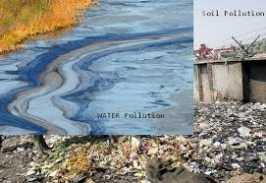
Look at the pictures below and discuss the questions and discuss the questions.
1. What do you see in each picture?
2. What are some common sources of environmental pollution?
3. Which of these sources are most threatening of our environment?

Slide 4
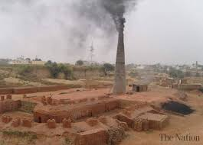
Today’s topic is ‘Environmental Pollution’

Slide 5
Learning outcomes:
After we have studied this lesson, we will be able to---
choose the best answer from the alternatives
ask and answer questions.
write a paragraph on ‘Environment Pollution’.

Slide 6
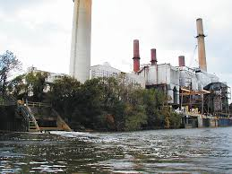
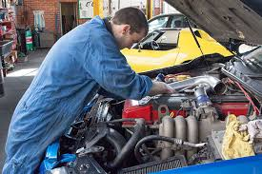
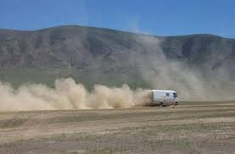
Let’s look at the pictures below and try to understand what the pictures mean
Environment pollution means the degradation of the main element of the environment . Air, water and soil etc. are the main elements of the environment . In Bangladesh poisonous exhaust from industrial plants, old or poorly-serviced vehicles and dust.

Slide 7
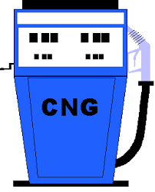
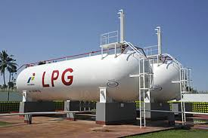
Look at the pictures and read under the text.
To protect our environment from air pollution, we can encourage people to use Compressed natural Gas(CNG) or Liquid Petroleum Gas (LPG) for fueling their cars.

Slide 8
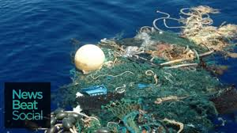
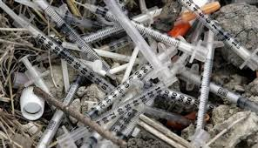
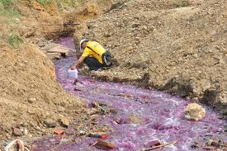
Look at pictures and read under the text.
Water pollution means contamination of surface and drinking water to the extent that they are harmful to use. Water pollution can occur in oceans, rivers, lakes, ponds and underground reservoirs. Throwing away a toxic substance on water, industrial wastages, wastes and filth etc. are polluting water.

Slide 9
Choose the best answer from the following alternatives
Individual work
5 -minutes
1.We can decrease air pollution by –
a) Making less use of motor vehicles b)maintaining the use of vehicles older than 20 years c) reducing the living abode d) using improper lubricants
2. The significant cause of soil pollution is-
Human waste b)carbon dioxide c) polythene d) industrial waste
3)Which of the following best describes the cause of water pollution?
a) Organic material that decay in water supplies. b) old or poorly-serviced vehicles. c) the use of Compress Natural Gas. d) dust from roads and

Slide 10
4. Which of the following words describes the effect of pollution?
a) Useful to all creatures on earth. b) accelerate climatic advantages. c) exercises no influence on environment. d) harmful to all creatures on earth.
5. Which of the following statement is true about the cause of soil pollution?
a)The enormous volume of industrial waste. b) the horn of vehicles. c) the advent of guest birds. d) the construction of high-rise buildings.
6. The antonym of ‘reduce’ is--.
a) Lessen b) increase c) shorten d) widen
7. Pesticide is one of the—
a) Pollutants b) medicine c) preservative d) fuels

Slide 11
Answer Key :
(1) B (2) d (3) a (4) d (5) a (6) b (7) a

Slide 12
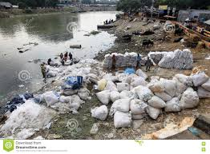
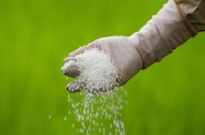
Now look at picture and read under the text.
Mills and factories throw their chemical wastes into rivers and canals and thus pollute water . In the rural areas, farmers use pesticides and chemical fertilizers which are washed away by rain and flood, pollute water.

Slide 13
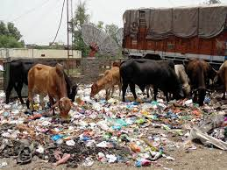
Look at the pictures and read under the text.
The mismanagement of household wastes, the polythene shopping bags, has caused serious threat to the soil, ad the drainage system. Another cause for soil pollution is the use of agricultural pesticides, fertilizers.

Slide 14
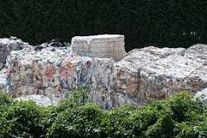
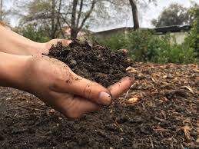
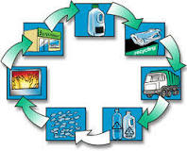
Look at the picture and read text carefully.
Recycling is way to reduce and control soil pollution. Recycling papers, plastics and other materials reduces the volume of refuse in landfills.

Slide 15
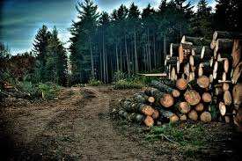
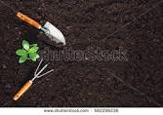
Deforestation also causes erosion ,pollution and the loss of fertility in the top soil.

Slide 16
Answer the following questions:
Pair work
10 minutes
a) How can we reduce air pollution ?
b) What are the causes of soil pollution?
c) Why are the city dwellers the worst sufferers of all kinds of pollution?
d) How is water polluted? Who are mainly responsible for this pollution?
e) Why is pollution on the increase? How can it be kept under control?

Slide 17
Answer key:
We can reduce air pollution by relocating hazardous industries, brick kilns to areas away from human habitation.
The causes of soil pollution are the mismanagement of household wastes, use of polythene shopping bag, deforestation, use of chemical fertilizers and insecticides etc.
According to the passage, the city dwellers are the worst sufferers of all kinds of pollution because in the cities, there are innumerable industries, mills and factories which create huge amounts of wastes.
Water pollution occurs due to increased sediment from soil,erosion,imp0roper waste disposal and littering organic materials that decay in water supplies.
5. Pollution is on the increase because people are increasing day buy day and to meet up the requirements of the increasing people, lots of industries, mills and factories are being set up which, in turn, create pollution .By following reuse, recycling and reduction of things, we can control pollution to a great extent.

Slide 18
Now watch the video and then try to write a paragraph to follow under the following questions.
Time:10 minutes
Questions
a)What do you mean by environment pollution?
b) How are the main elements of the environment being polluted?
c) What are the effects of environment pollution?
d) How can we save the environment from pollution?
e) Which steps should our government take to prevent environment pollution?

Slide 19
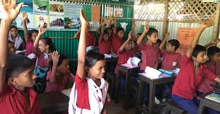
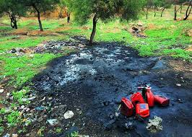
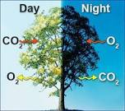
Evaluation
Look at the two posters below. What messages do they give? Which do you like most? Now give the answer of the following questions.
Questions:
What do the trees absorb and release.
2.What is the main cause of increasing carbon dioxide level?
3.What are the causes of soil pollution?
Picture-1
Picture-2

Slide 20

Home task
Write a paragraph on ‘Air pollution’.

Slide 21
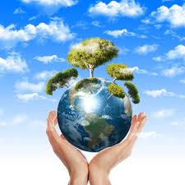
Thank you

